Slide 1
Booking System
Prepared by
B10815044 Hsieh, Jun-Yao
B10815054 Huang, Chen-En
B10815058 Pu, Chi-Hao
B10815057 Liao, Sheng-Hao
Group 8

Slide 2
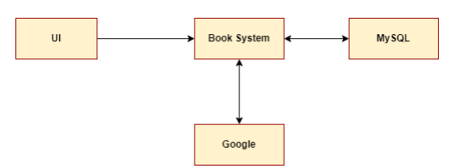
Team Members
Hsieh, Jun-Yao (Project Manager) (Developer) | Meeting Host Documents Management Develop and Manage Database Help to develop the main system System Test Job assignment and coordinate
Huang, Chen-En (Developer) | Google Calendar API interface Functional requirement implement Technical writer
Pu, Chi-Hao (UI Design) (Developer) | GUI design Technical writer System tester
Liao, Sheng-Hao (Program Manager) (Developer) | Core component design Core component implement Run & Build manual writer Google account provider Technical writer System tester

Slide 3
What is Booking System
An assistance system for user to book meeting room
Multiuser, multitasking systems
Provides graphical user interface operation
Integrate with google calendar

Slide 4
The Goal of BookSystem
Makes the process of booking meetings easier and faster
Remind attendees to join the meeting
Provide a system that can modify booking information

Slide 5
Why choose BookSystem
Stable and reliable system
User friendly UI
Allow multiple people to edit information at the same time
Not limited to local area network

Slide 6
BookSystem Structure
BookSystem can be roughly divided into four subsystems
Core
Database
User interface
Google calendar

Slide 7
How BookSystem work
The user issues an operation request through the UI
The request will be sent to the core subsystem
Then send operation requests to the database and google calendar
If the database is updated by others, the core subsystem will reflect the new state to other subsystems
Present the feedback results to the UI

Slide 8
How the details are implemented
When a new meeting is being added :
Check if time conflicts with other meetings in the same room
When a new meeting is successfully added :
Add meeting to attendee’s calendar using google calendar api
Send mail reminders to attendee’s email
Store new meeting to database
Change shows on the UI

Slide 9
How the details are implemented
When the room is being used
Show "in use" on UI
The "My meeting" interface will display all the meetings of the user
Most recent to oldest
Display meeting name, room name, time period
When the meeting is deleted :
Delete meeting from attendee’s calendar using google calendar api
Google calendar will send email to participants
Delete meeting from database
Delete new meeting from timeline

Slide 10
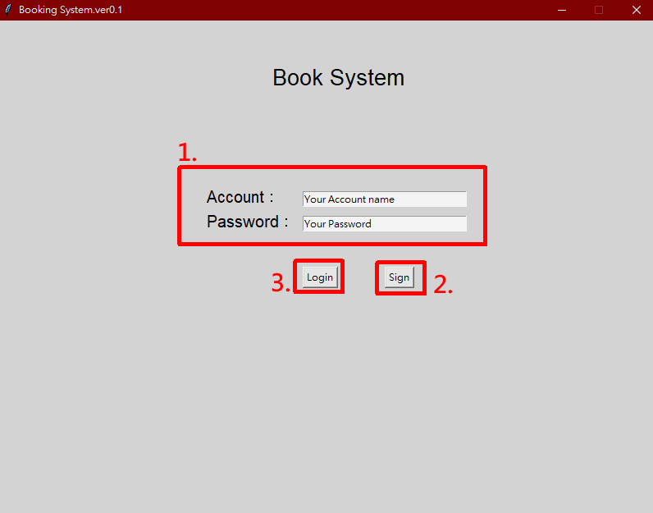
操作流程-登入
填入帳號資訊
點擊註冊帳號
點擊登入

Slide 11
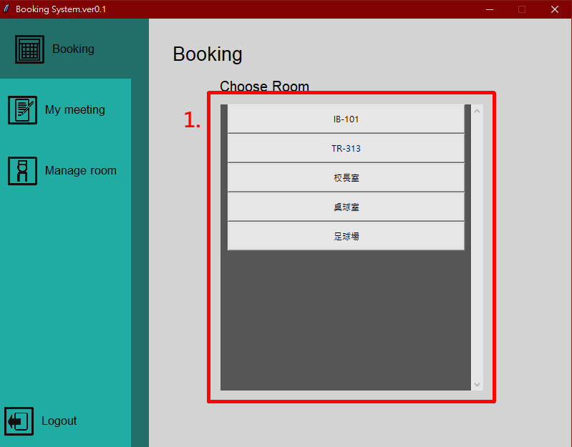
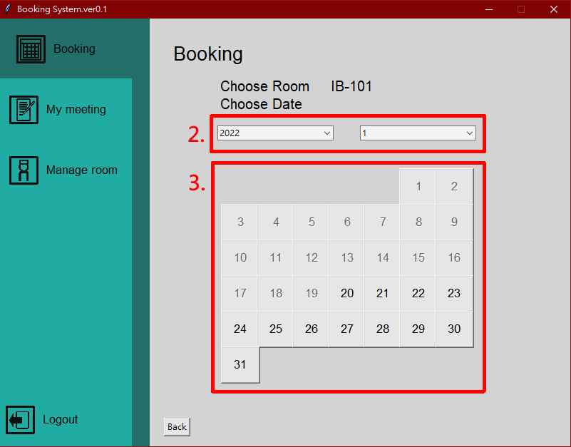
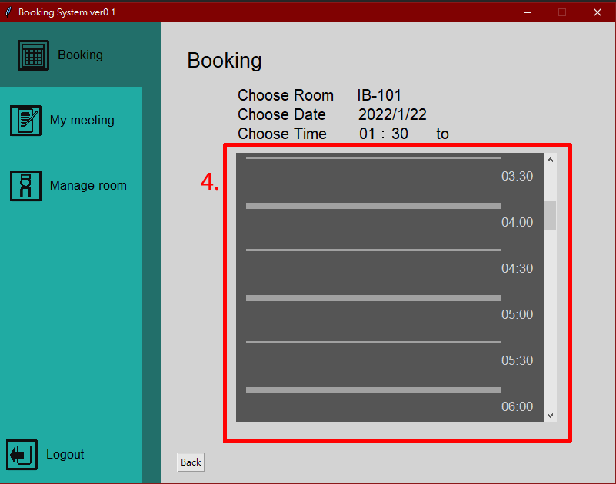
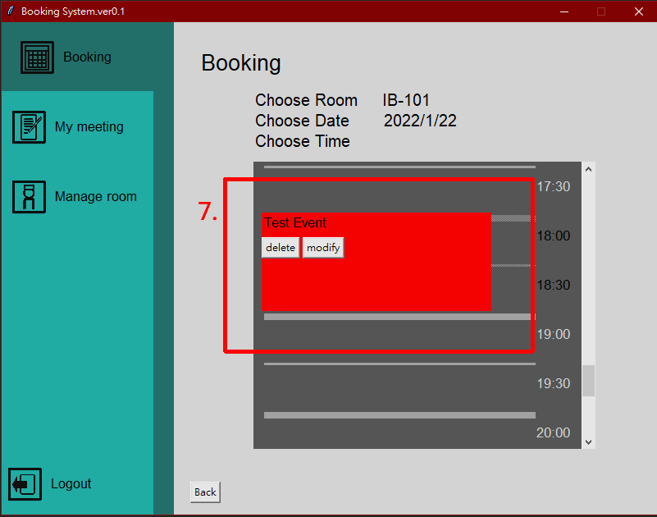
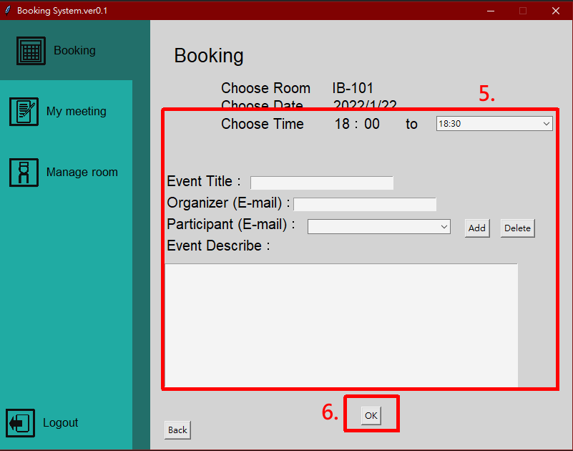
操作流程-預約
選擇房間
選擇年份與月份
選擇日期
選擇開始時間
填入其他資訊
點選確認按鈕
成功建立事件

Slide 12
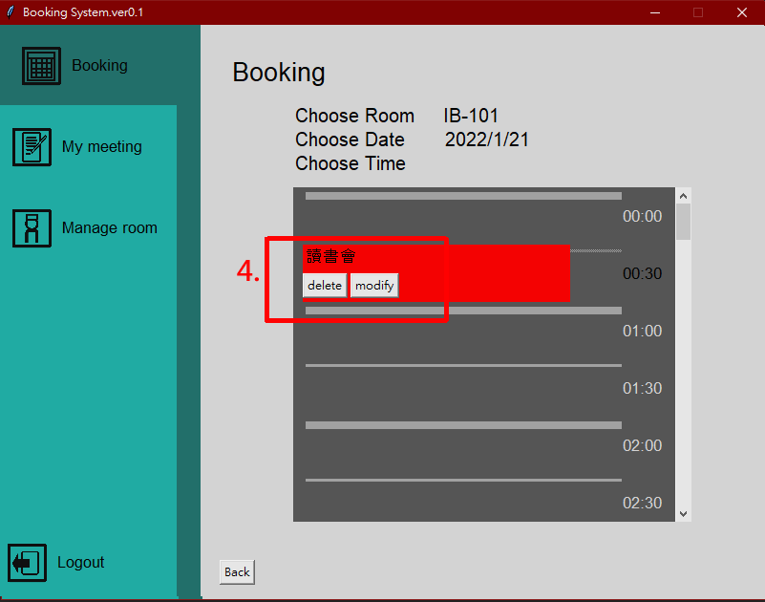
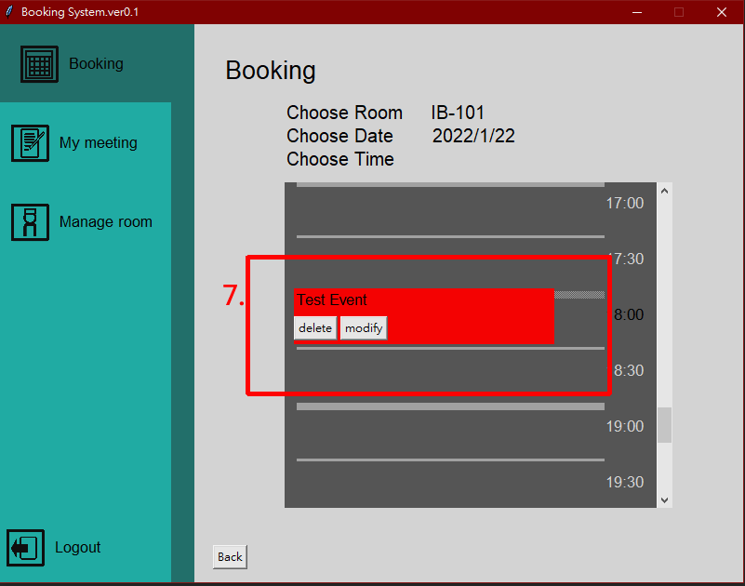
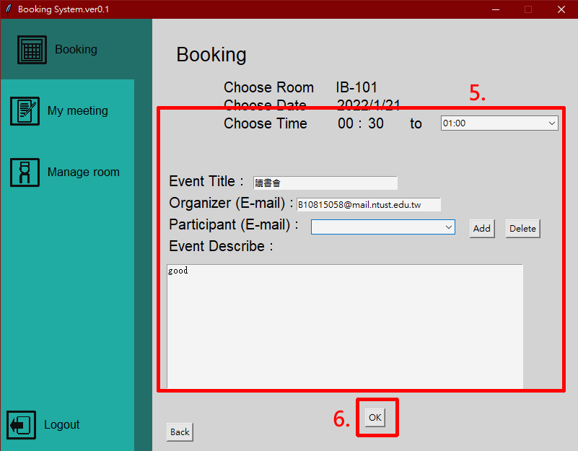
操作流程-修改事件
選擇房間
選擇年份與月份
選擇日期
選擇修改事件
修改事件內容
點選確認按鈕
成功修改事件

Slide 13
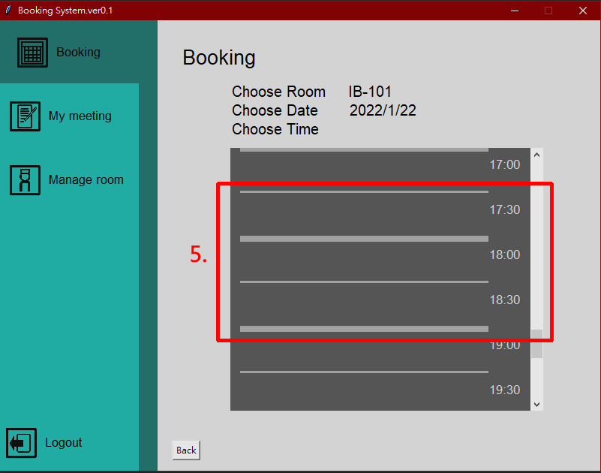
操作流程-刪除事件
選擇房間
選擇年份與月份
選擇日期
選擇刪除事件
事件刪除成功

Slide 14
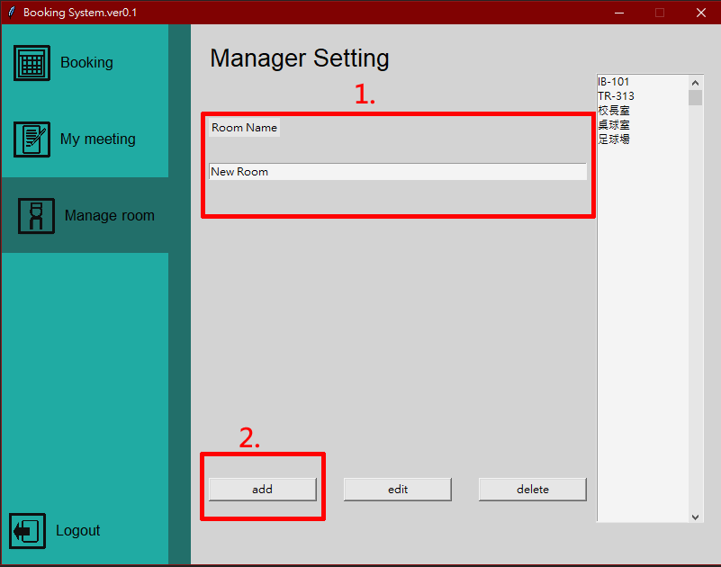
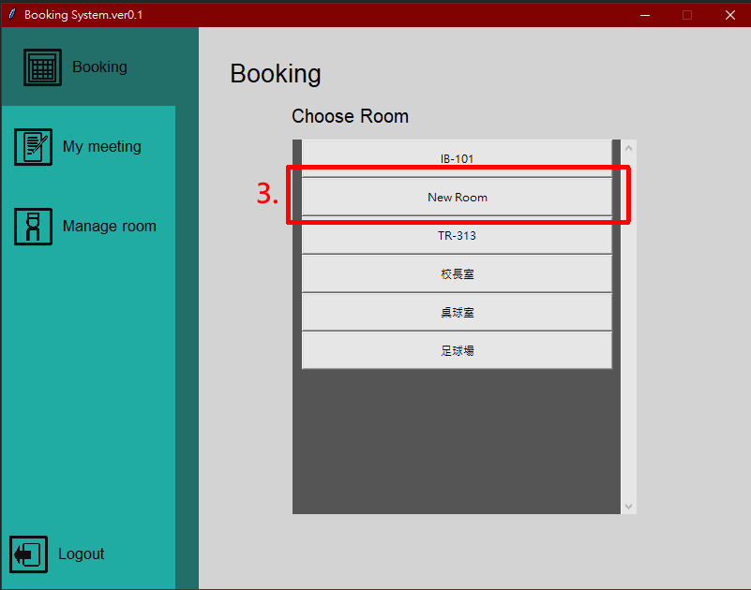
操作流程-建立會議室
填入房間名稱
點選新增
成功建立房間

Slide 15
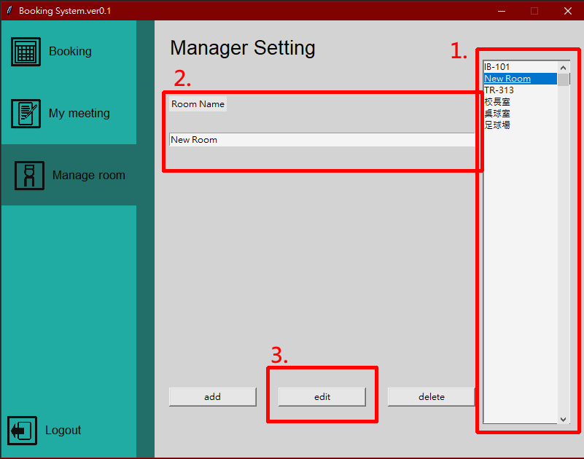
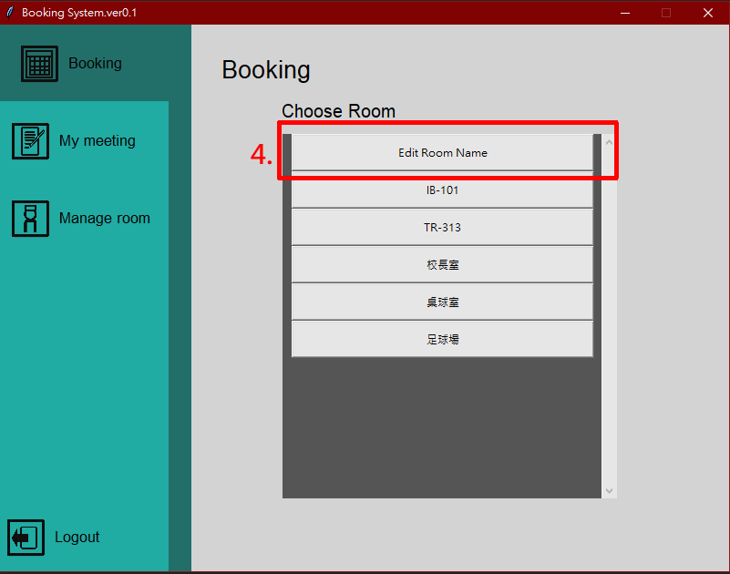
操作流程-修改會議室
選擇欲修改房間
填入房間新名稱
點選修改
成功修改房間

Slide 16
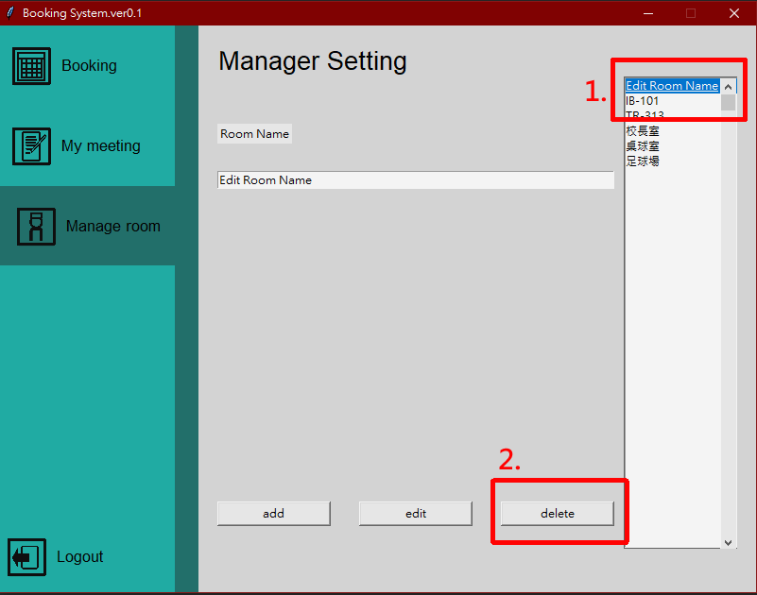
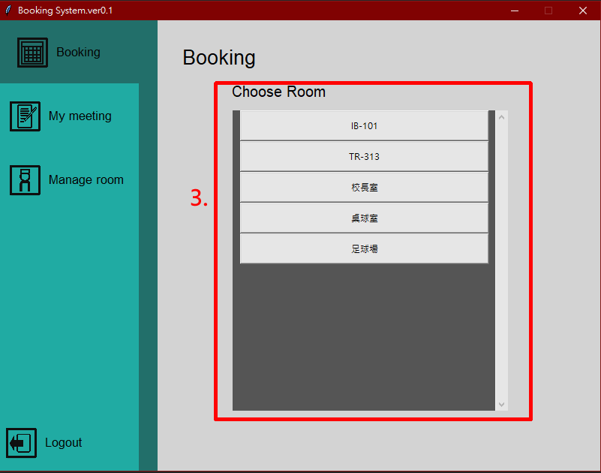
操作流程-刪除會議室
選擇欲刪除房間
點選刪除
成功刪除房間

Slide 17
Features
Flexible to make further change
Customized and Beautiful GUI
The change in the system will also apply to Google calendar
Very easy and convenient to use

Slide 18
Limitation
The participant not allow two meeting at same time
The room not allow two meeting at same time

Slide 19
Functional requirements
Manage Meeting rooms：Create/Delete/Modify Meeting rooms
Manage Meeting ：Create/Delete
Modify Meeting Information：Modify the title, time, participants, description
Show my meeting ：To show the meetings user attends
Login/Register
System Synchronization

Slide 20
Non-Functional requirement
Safety requirement
Backup database to prevent users from doing irreversible or illegal operations.
Security requirement
Verify the user’s identity before user access to database.

